Slide 1
Big Data Analytics

Slide 2
About Me
Graduated from the University of Pennsylvania in 2009 with a BA in Economics and International Relations
Currently studying for part-time Masters at Harvard Extension School
2.5 years in aviation consulting marketing new routes to airlines
2.5 years in doing marketing automation and analytics for an automotive client at a digital marketing agency
Currently working for a SaaS company doing product analytics for their growth team

Slide 3



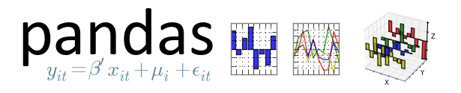



Typical Big Data Analysis Process
Cloud Storage and Query
Analysis Tool for Cleaning
Modeling using Packages
+
SQL-like languages are used to extract subsets and aggregates from hundreds of millions of rows across multiple tables
Exploratory data analysis is conducted on extracted data to set baselines. Then the data is manipulated into a format that can be plugged into modeling packages
R and Python both have modeling packages that can be used to quickly apply statistical and natural language models to data

Slide 4

Case Study 1: Leading Indicators for long-term success
Use BQL (Big Query Language) to subset and aggregate data into manageable form (usually 1M+ rows *.csv.gz file)
Use Pandas to clean data and plot into charts for exploratory data analysis
Using logistic models in Statsmodels or decision trees in Scikit-learn to figure out the most important variables
Prototype and plot custom models for establishing custom thresholds (aha! moment) in Excel
Automate generation of model results and export into a csv or xlsx format

Slide 5
Case Study 2: Identify user interests from search terms
Use Amazon EC2 and Hive to subset, aggregate and extract data into a *.csv.gz file
Use RStudio to clean and manipulate data to extract relevant search terms to plug into topicmodels
Use to topicmodels package in R to cluster keywords into topics to attempt to extract search interests

Slide 6


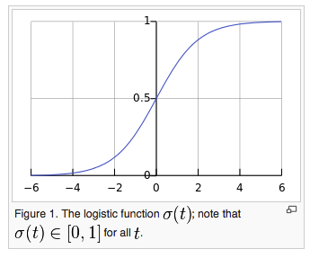


Logistic Regression
Logistic regression is used when the dependent variable is dichotomous/binary. It is a transformation of linear regression such that the dependent variable is now a probability between 0 and 1
Coefficient (log-odds):
Probability:

Slide 7
Walkthrough of identifying possible hall of famers from baseball data in Python
iPython Notebook (external link)
Techniques Demonstrated:
SQL
Python - Pandas with Matplotlib
Statsmodels
Scikit-learn

Slide 8
Predictive Modeling in Education - Predicting College Enrollment from Middle School Tutoring software usage
This case study comes from the (Massively Open Online Course) Big Data in Education (see citation)
It utilizes logistic regression to predict if a student will attend college data gathered from their usage of math tutoring software in middle school
The population for this dataset was 3,747 students from 3 school districts in Massachusetts from 2004-2007 who completed 494,150 math problems and made 2,107,108 attempts or hint requests in the software of which 58% attended college
Features examined are student knowledge, correctness, boredom, engaged concentration, confusion, off-task, gaming, carelessness, number of first actions (eg. attendance)
The model was able to predict with 65% accuracy and able to explain 10% of the variation of whether a student will attend college
The final model is: CollegeEnrollment = + 1.119 StudentKnowledge + 0.698 Correctness + 0.261 NumFirstActions – 1.145 Carelessness + 0.217 Confusion + 0.169 Boredom + 0.351
Implications are that interventions by the software and teachers may have significant long term effects if they address boredom, confusion, carelessness and gaming the system
San Pedro, M.O.Z., Baker, R.S.J.d., Bowers, A.J., Heffernan, N.T. (2013) Predicting College Enrollment from Student Interaction with an Intelligent Tutoring System in Middle School. Proceedings of the 6th International Conference on Educational Data Mining, 177-184. [pdf] [video] [course]
Notes:
Logistic Regression Case Study: San Pedro, M.O.Z., Baker, R.S.J.d., Bowers, A.J., Heffernan, N.T. (2013) Predicting College Enrollment from Student Interaction with an Intelligent Tutoring System in Middle School. Proceedings of the 6th International Conference on Educational Data Mining, 177-184. [pdf] [video] [course]

Slide 9
Resources
Using Google BigQuery Language (BQL): https://cloud.google.com/bigquery/query-reference
Identify leading indicators using Excel (I automated the method in Python): http://www.quora.com/Growth-Hacking/How-do-you-find-insights-like-Facebooks-7-friends-in-10-days-to-grow-your-product-faster
Topics modeling in R: https://notesofdabbler.wordpress.com/2014/09/27/exploring-mangalyaan-tweets-with-r/
Columbia University MOOC Textbook Big Data and Education: http://www.columbia.edu/~rsb2162/bigdataeducation.html

